Slide 1
UNIT –IV TRANSFORMER
Presented
BY
LAVANYA

Slide 2
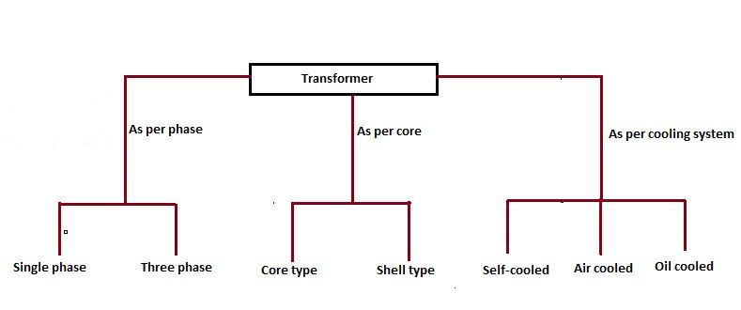
What is a Transformer?
A transformer is a device used in the power transmission of electric energy. The transmission current is AC. It is commonly used to increase or decrease the supply voltage without a change in the frequency of AC between circuits. The transformer works on basic principles of electromagnetic induction and mutual induction.
Transformer Types
Transformers are used in various fields like power generation grid, distribution sector, transmission and electric energy consumption. There are various types of transformers which are classified based on the following factors;
Working voltage range.
The medium used in the core.
Winding arrangement.
Installation location.

Slide 3
Based on Voltage Levels
Commonly used transformer type, depending upon voltage they are classified as:
Step-up Transformer: They are used between the power generator and the power grid. The secondary output voltage is higher than the input voltage.
Step down Transformer: These transformers are used to convert high voltage primary supply to low voltage secondary output.
Based on the Medium of Core Used
In a transformer, we will find different types of cores that are used.
Air core Transformer: The flux linkage between primary and secondary winding is through the air. The coil or windings wound on the non-magnetic strip.
Iron core Transformer: Windings are wound on multiple iron plates stacked together, which provides a perfect linkage path to generate flux.
Based on the Winding Arrangement
Autotransformer: It will have only one winding wound over a laminated core. The primary and secondary share the same coil. Auto also means “self” in language Greek.

Slide 4
Based on Install Location
Power Transformer: It is used at power generation stations as they are suitable for high voltage application
Distribution Transformer: Mostly used at distribution lanes for domestic purposes. They are designed for carrying low voltages. It is very easy to install and characterized by low magnetic losses.
Measurement Transformers: These are further classified. They are mainly used for measuring voltage, current, power.
Protection Transformers: They are used for component protection purposes. In circuits, some components must be protected from voltage fluctuation etc. Protection transformers ensure component protection.

Slide 5
What is a Single Phase Transformer?
A single phase transformer is a type of transformer which operates on single-phase power.
A transformer is a passive electrical device that transfers electrical energy from one circuit to another through the process of electromagnetic induction.
It is most commonly used to increase (‘step up’) or decrease (‘step down’) voltage levels between circuits.
A single phase transformer consists of a magnetic iron core serving as a magnetic transformer part and transformer cooper winding serving as an electrical part.
A single phase transformer is a high-efficiency piece of electrical equipment, and its losses are very low because there isn’t any mechanical friction involved in its operation.
Transformers are used in almost all electrical systems from low voltage up to the highest voltage level. It operates only with alternating current (AC) because direct current (DC) does not create any electromagnetic induction.

Slide 6
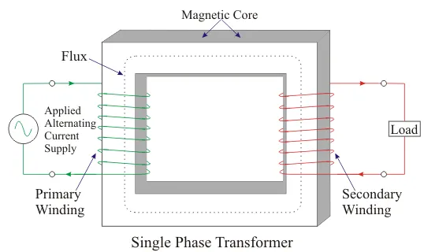

Depending on the electrical network where the transformer is installed, there are two transformer types, three-phase transformers and single phase transformers.

Slide 7
The operation principle of the single-phase transformer is: the AC voltage source injects the AC current through the transformer primary winding.
The AC current generates the alternating electromagnetic field. The magnetic field lines are moving through iron transformer core and comprise the transformer secondary circuit.
Thus the voltage is induced in the secondary winding with the same frequency as the voltage of the primary side. The induced voltage value is determined by Faraday’s Law.
Where,
f→frequencyHz
N → number of winding turns
Φ → flux density Wb
If the load is connected on the secondary transformer side the current will flow through secondary winding. Basically, the single phase transformers can operate as step up transformer or step down transformers.

Slide 8
The main parts of a transformer are windings, core, and isolation.
The windings should have small resistance value and usually they are made of copper (rarely of aluminum). They are wound around the core and must be isolated from it.
Also, the turns of the winding have to be isolated from each other.
The transformer core is made from very thin steel laminations which have high permeability.
The laminations have to be thin (between 0.25 mm and 0.5 mm) because of decreasing power losses (known as eddy current losses).
They have to be isolated from each other, and usually, the insulating varnish is used for that purpose. The transformer insulation can be provided as dry or as a liquid-filled type.
The dry-type insulation is provided by synthetic resins, air, gas or vacuum.
It is used only for small-size transformers (below 500 kVA). The liquid insulation type usually means using mineral oils.
The oil has a long life cycle, good isolation characteristics, overload capability, and also provides transformer cooling. Oil insulation is always used for big transformers.

Slide 9
The single phase transformer contains two windings, one on primary and the other on the secondary side. They are mostly used in the single-phase electrical power system.
The three-phase system application means using three single-phase units connected in the three-phase system. This is a more expensive solution, and it is used in the high voltage power system.

Slide 10
Applications of Single Phase Transformer
The advantages of three single-phase units are transportation, maintenance, and spare unit availability.
The single-phase transformers are widely used in commercial low voltage applications as electronic devices.
They operate as a step-down voltage transformer and decrease the home voltage value to the value suitable for electronics supplying.
On the secondary side, a rectifier is usually connected to convert an AC voltage to the DC voltage which is used in electronics applications.

Slide 11
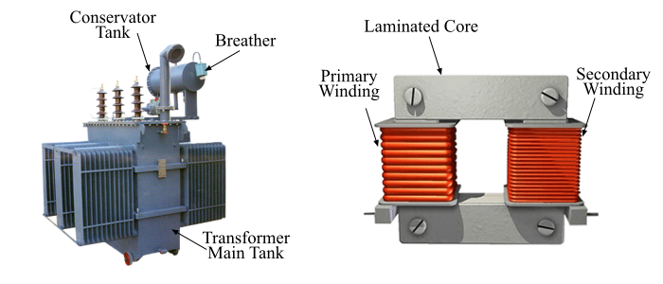
Transformer
A transformer is a static electrical machine which is used for either increasing or decreasing the voltage level of the AC supply with a corresponding decrease or increase in the current at constant frequency.
Parts of a Transformer
A typical transformer essentially consists of following main parts −
Magnetic Core
Transformer Windings
Transformer Body /
Tank and Dielectric Oil
Oil Conservator Tank
Breather

Slide 12
Magnetic Core
The core of the transformer is made up of magnetic materials having high permeability. As the transformer is subjected to the AC supply, thus its core is built up of thin lamination stacked together to reduce the eddy current losses in the core. The windings of the transformer are wound on the core of the transformer. The core of the transformer mainly serves two purposes as,
It provides support to the windings.
It provides a low reluctance path to the magnetic flux.
Transformer Windings
The transformer consists of two windings viz. the primary winding and the secondary winding. The winding connected to the source of AC supply is called as the primary winding while the winding of the transformer to which the load is connected is known as the secondary winding. The AC voltage V₁ whose magnitude is to be changed is applied across the primary winding.
Depending upon the number of turns in the primary and secondary windings, an alternating EMF (E₂) being induced in the secondary winding of the transformer. This induced EMF (E₂) results a load current I₂, hence a terminal V₂ would appear across the load.
If V₂> V₁, the transformer is said to be step-up transformer. On the other hand, if V₁ > V₂, the transformer is said to be step-down transformer.

Slide 13
Transformer Body / Tank and Dielectric Oil
The transformer tank provides protection to the core and the windings of the transformer.
The transformer core and windings arrangement are immersed in the tank containing dielectric oil.
The dielectric oil / insulating oil acts as an insulating medium for the core and windings of the transformer and it also absorbs the heat generated, hence it works as cooling medium of the transformer.
Oil Conservator Tank
The main tank of the transformer is connected through a pipe to a small tank, called as conservator tank.
The main function of the conservator tank is to keep the transformer tank completely filled with the dielectric oil at all operating conditions.
The conservator tank is designed to act as a reservoir for the transformer oil.
When the temperature of the transformer is increased, the oil inside the transformer being expended. The conservator tank provides space for this expansion of the dielectric oil.

Slide 14
Breather
The breather of the transformer consists of silica gel, which prevents any atmospheric moisture from entering the tank of the transformer with air.
When the temperature of the transformer goes down, it will make the dielectric oil to contract and hence the atmospheric air gets inhaled by the transformer.
Thus, all the moisture of the air gets absorbed by silica gel of the breather.

Slide 15
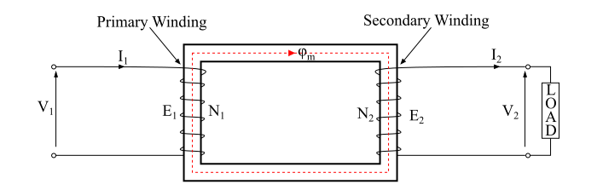
Working Principle of Transformer
The working of the transformer is based on the principle of mutual inductance between two coils which are magnetic coupled.
According to the principle of mutual inductance, when an alternating voltage is applied to the primary winding of the transformer, an alternating flux ϕ_{m} which is called as the mutual flux is produced in the core.
This alternating flux links both the windings magnetically and induces EMFs E₁ in the primary winding and E₂ in the secondary winding of the transformer according to Faraday’s law of electromagnetic induction.
The EMF (E₁) is called as primary EMF and the EMF (E₂) is known as secondary EMF and being given as,

Slide 16
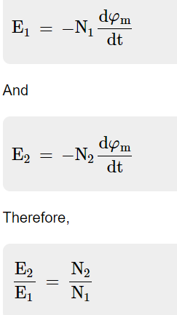

Slide 17
From the above expression it can be seen that the magnitude of EMFs E₁ and E₂ depend upon the number of turns in the primary and secondary windings of the transformer respectively, i.e., if N₂ > N₁, then E₂ > E₁, thus the transformer will be a step-up transformer and if N₂ < N₁, then E₂ < E₁, thus the transformer will be a step-down transformer.
If a load is now connected across the secondary winding, the EMF E₂ will cause a load current I₂ to flow through the load.
Therefore, a transformer enables the transfer of power from one electric circuit to another with a change in voltage level.

Slide 18
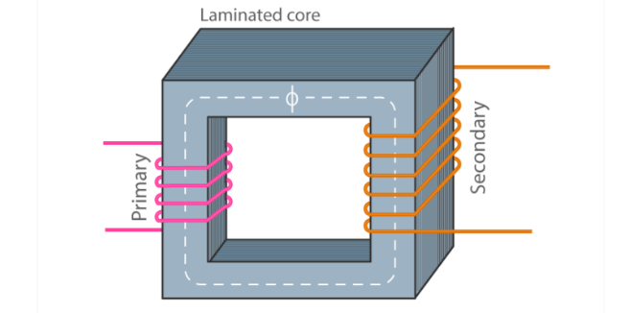
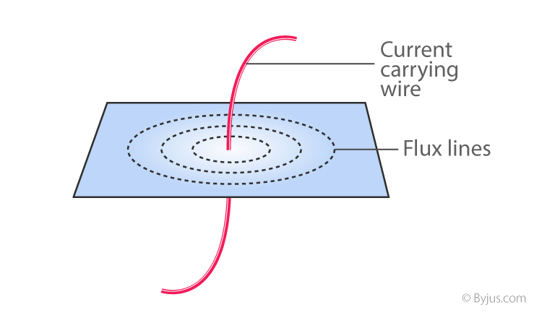
Working Principle of a Transformer
The transformer works on the principle of Faraday’s law of electromagnetic induction and mutual induction.
There are usually two coils primary coil and secondary coil on the transformer core.
The core laminations are joined in the form of strips. The two coils have high mutual inductance.
When an alternating current pass through the primary coil it creates a varying magnetic flux.
As per faraday’s law of electromagnetic induction, this change in magnetic flux induces an emf (electromotive force) in the secondary coil which is linked to the core having a primary coil. This is mutual induction.
Overall, a transformer carries the below operations:
Transfer of electrical energy from circuit to another
Transfer of electrical power through electromagnetic induction
Electric power transfer without any change in frequency
Two circuits are linked with mutual induction

Slide 19
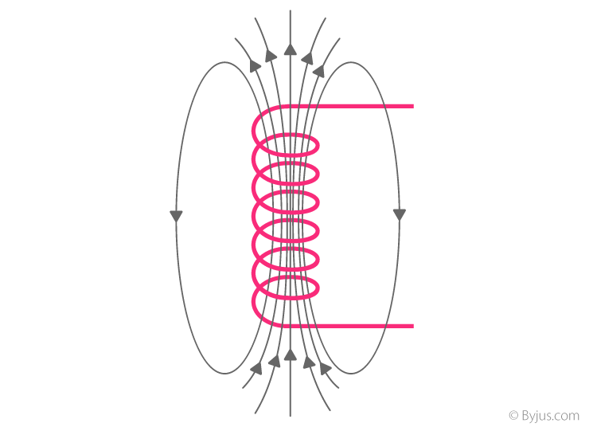
The figure shows the formation of magnetic flux lines around a current-carrying wire. The normal of the plane containing the flux lines are parallel to normal of a cross-section of a wire.
The figure shows the formation of varying magnetic flux lines around a wire-wound.
The interesting part is that reverse is also true, when a magnetic flux line fluctuates around a piece of wire, a current will be induced in it.
This was what Michael faraday found in 1831 which is the fundamental working principle of electric generators as well as transformers.

Slide 20
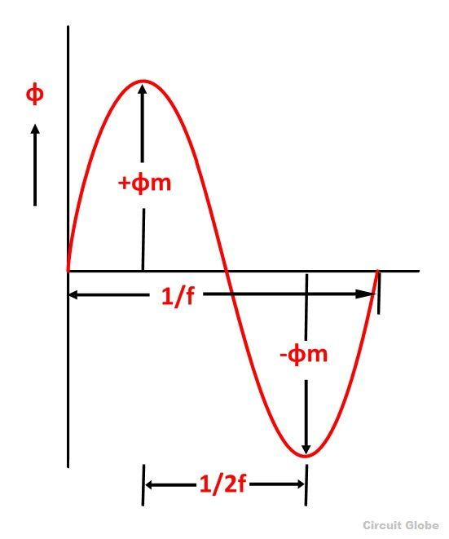
EMF Equation of a Transformer
When a sinusoidal voltage is applied to the primary winding of a transformer, alternating flux ϕ_{m} sets up in the iron core of the transformer.
This sinusoidal flux links with both primary and secondary winding.
The function of flux is a sine function.
The rate of change of flux with respect to time is derived mathematically.
The derivation of the EMF Equation of the transformer is shown below. Let
ϕ_{m} be the maximum value of flux in Weber
f be the supply frequency in Hz
N₁ is the number of turns in the primary winding
N₂ is the number of turns in the secondary winding
Φ is the flux per turn in Weber

Slide 21
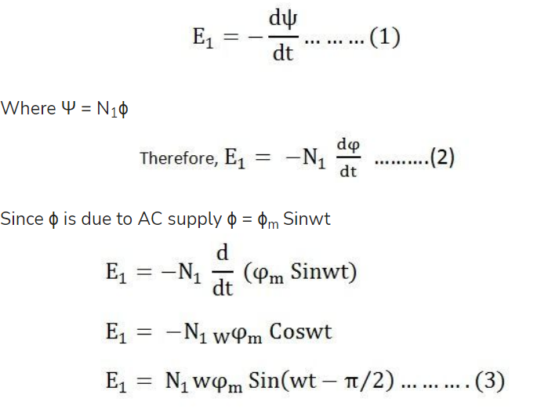
As shown in the above figure that the flux changes from + ϕ_{m} to – ϕ_{m} in half a cycle of 1/2f seconds.
By Faraday’s Law
Let E₁ be the emf induced in the primary winding

Slide 22
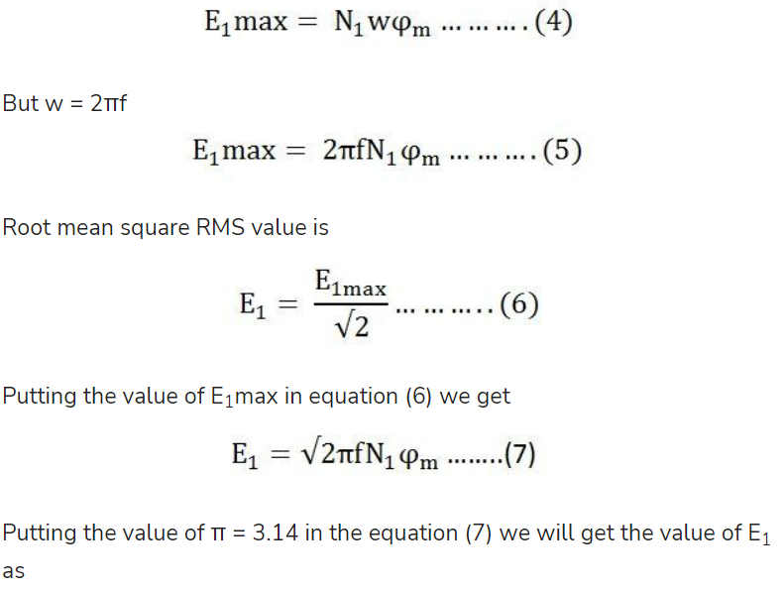
So the induced emf lags flux by 90 degrees.
Maximum valve of emf

Slide 23
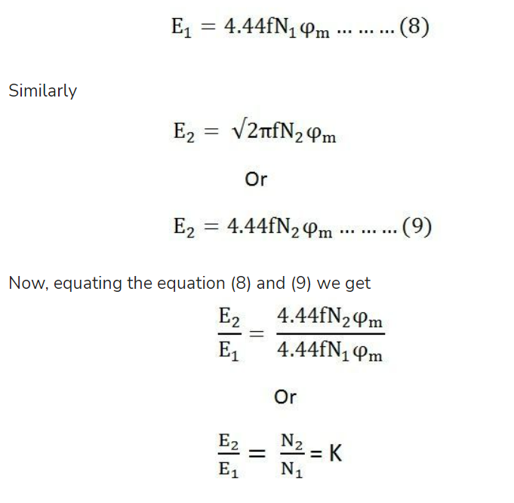

Slide 24
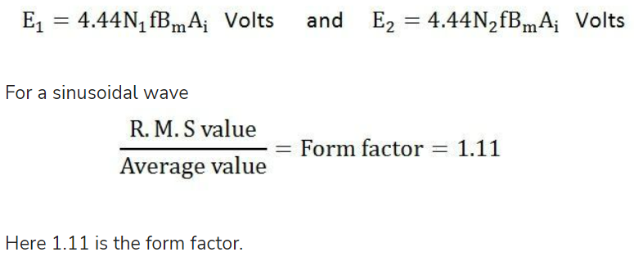
The above equation is called the turn ratio where K is known as the transformation ratio.
The equation (8) and (9) can also be written as shown below using the relation
(ϕm = B_{m} x A_{i}) where A_{i} is the iron area and B_{m} is the maximum value of flux density.

Slide 25
What is the working principle of the transformer?
The transformer works on the principle of mutual induction.
List the three types of transformers based on voltage level?
Based on the voltage level, the transformer is of three types Step-up transformer Step-down transformer Isolation transformer
What are the main parts of a transformer?
Iron core Primary winding Secondary winding
Why do the transformers burn and explode?
The transformers burn and explode when lightning strikes, overloading, corrosion, power surges etc.
What is a transformer?
A transformer is a device used for stepping up or stepping down AC voltages.
What is a step-up transformer?
A step-up transformer is one for which the output voltage is greater than the input voltage.
What is a step-down transformer?
A step-down transformer is one for which the output voltage is less than the input voltage.
Define the turns ratio of the transformer.
The turns ratio of a transformer is the ratio of the number of turns in the secondary to that of the primary.

Slide 26
Construction of Single - Phase Transformers
A single-Phase transformer consists of primary and secondary winding.
The core of the transformer is made of thin sheets (called laminations) of high grade of silicon.
These laminations are provided in the transformer to reduce eddy-current loss, and the silicon steel reduces hysteresis loss.
The laminations present in the transformer are insulated from one another by heat resistant enamel coating. L - Type and E- type laminations are used for constructions.
There are two basic types of transformer constructions:
Core type construction.
Shell type construction.

Slide 27
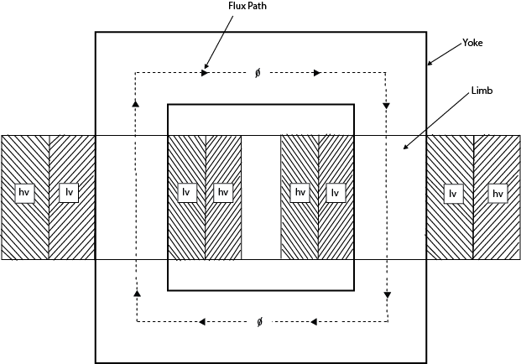
Core type Construction
In the core type transformer, the magnetic circuit consists of two vertical legs or limbs with two horizontal sections, called yokes.
To minimize the leakage flux, half of each winding is placed on each leg of the core.
The low voltage winding is placed next to the core, and the high voltage winding is placed around the low voltage winding to reduce the insulating material required.
Thus, the two winding are arranged as concentric coils. Such type of winding is called as concentric winding or cylindrical winding.

Slide 28
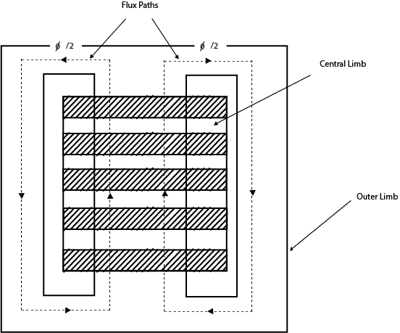
Shell type Construction
In the shell type transformer, both the primary and secondary winding are wounded on the central limb, and the low reluctance path is completed by the outer limbs.
Each winding is subdivided into sections.
Low voltage (lv) and High voltage (hv) subsections are alternatively placed in the form of sandwich that is why this winding is also called sandwich or disc winding.

Slide 29
The core is made up of two types of laminations. The laminations for the core type are U, and I shaped.
Firstly the U- shaped laminations are stacked together for the required length. Half of the prewound low voltage coil is placed around the limbs.
The lv coil is further provided with insulation.
Then half of the prewound hv coil is placed around the lv coil. The core is then closed by the I-shaped laminations at the top.

Slide 30
Ideal Transformer
An Ideal transformer is an imaginary transformer which has the following properties:
Its primary and secondary winding resistances are negligible.
The core has infinite permeability (µ) so that negligible mmf is required to establish the flux in the core.
Its leakage flux and leakage inductances are zero. The entire flux is confined to the core and links both windings.
There are no losses due to resistance, hysteresis and eddy currents. Thus, the efficiency is 100 percent.
Ideal iron-core transformer

Slide 31
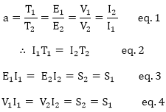
The transformer that has zero primary and zero secondary impedance, is called an ideal transformer.
The applied voltage V1 in the primary is equal to the induced voltage E1.
Similarly, the induced voltage E2 is equal to the output voltage V2 of the secondary.
For an ideal transformer, if a = transformation ratio = turn ratio
Then,
The equation-2 states that the demagnetizing, ampere-turns of the secondary are equal
and opposite to the magnetizing mmf of the primary of an Ideal transformer.
No-load Phasor diagram of an ideal transformer.

Slide 32
Applications of Transformers
The level of voltage and current can be changed in electrical power systems.
Transformer known as instrument transformer is used to measure the voltage and current.
In combined ac/dc power systems, the transformers are used to convert hvac to hvdc.
To isolate one circuit from another, since primary and secondary are not connected.

Slide 33

Ideal & Practical Transformer
Ideal Transformer
A ideal transformer is an imaginary transformer which has:
-> no copper losses
-> no iron loss in the core
-> no leakage flux
More on losses Here
In ideal transformer, input power = output power. Concept of such transformer exists to make problems easier. Characteristics of Ideal Transformer
Zero Winding Resistance : Resistance of both primary and secondary winding is 0 i.e. both the coils are purely inductive in nature. 100% Efficiency : There are no losses in ideal transformer so the input power = output power

Slide 34

No leakage flux : The whole amount of flux is linked from primary to secondary winding, so there is no leakage flux.
No Iron loss : As the iron core is subjected to alternating flux there occurs eddy current and hysteresis loss in it. These two losses together are called Iron loss. It is 0 in ideal transformer.
When an alternating voltage V₁ is supplied to the primary winding of an ideal transformer, counter emf E₁ is induced in the primary winding. Since there is no resistance, this induced emf E₁ will be exactly equal to the applied voltage but in 180 degree opposite in phase.
The current drawn from the source produces required magnetic flux. As the primary winding resistance is 0, the current lags emf E₁ by 90 degree. This is current is called Magnetizing current I_{μ}. This magnetizing current produces alternating magnetic flux φ.
This flux gets linked with the secondary winding and emf E₂ is induced by mutual induction. This E₂ is in phase with E₁. If the circuit is closed at secondary winding, then secondary current I₂ is produced.

Slide 35
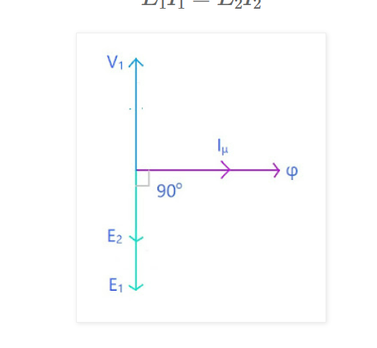

Slide 36
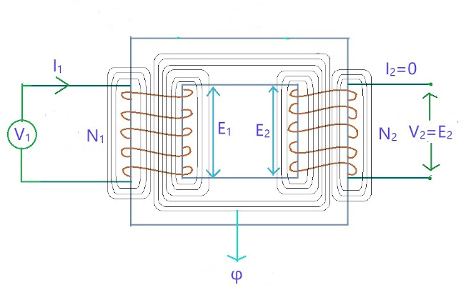
Practical Transformer
In practical transformer, we have all sorts of losses that were 0 in ideal transformer like winding reistance, leakage flux, and iron losses, all are there. Here we are gonna study two cases:
(a) No load (b) On load
Practical Transformer on No Load
In no load transformer, the circuit on the secondary side is open.

Slide 37
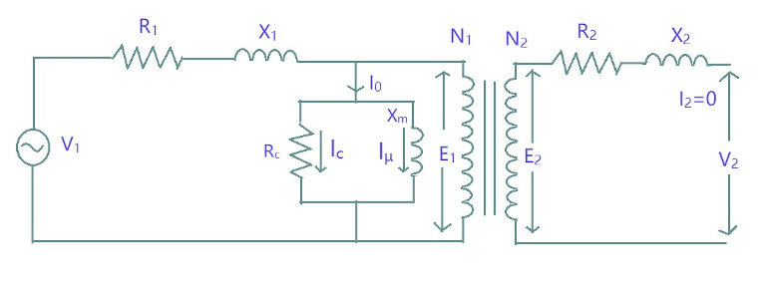
V₁ is the primary voltage and I₁ is the primary current.
Now I₁ has two components: a) One component is responsible for generation of magnetic flux. This is called Magnetizing component of I₁ and is denoted by I_{μ}
b) Second component which is responsible for magnetic losses (Hysterisis and Eddy current losses) and primary winding losses. This is called Core loss component of I_{c} .
So its equivalent circuit diagram is:

Slide 38
where on primary side,
V₁ is Primary Voltage
R₁ is Primary Winding Resistance
X₁ is Primary Leakage Reactance
I₀ is No Load Primary Current
I_{c} is Core Loss component of I1 inphase with the supply voltage
I_{μ/ Im} is Magnetizing Component of I_{1 inphase with the flux}
R_{c} is Core loss resistance
X_{m} is Magnetizing Reactance
N₁ is Number of turns in Primary Winding
E₁ is Primary induced Emf

Slide 39
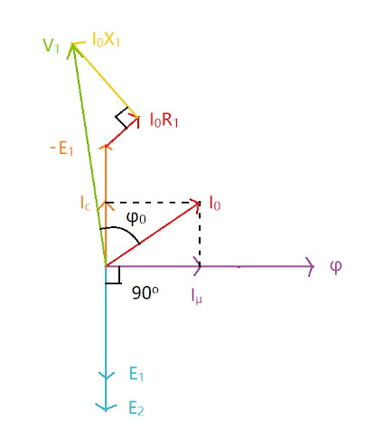
On secondary side:
R₂ is Secondary winding resistance
X₂ is Secondary leakage reactance
N₂ is Secondary winding turns
E₂ is Secondary induced emf
V₂ is Secondary terminal voltage
Phasor Diagram

Slide 40

Explanation
First we will start with reference line which is common to both
primary and secondary curcuit, here it is flux φ. Now using KVL in primary circuit
There is no direct relation between φ and V₁ so that we could directly draw phasor. But we have relation with E₁ and φ, as φ is responsible for both E₁ and E₂. E₁ and E₂ both lag φ by 90 degrees. Here we will consider E₁ < E₂.
φ is produced due to magnetizing current I_{μ} therefore I_{μ} is in phase with φ. As we have -E₁ in our equation (because it is in opposite direction of magnetizing current) so we will draw a phasor opposite to E₁. I_{c} is 90 degrees leading from I_{μ} so it is in phase with -E₁ As I₀ = I_{c} + I_{μ} , hence the phasor I₀.
Now I₀R₁ is voltage drop in R₁ and it is in phase with I₀ , and as it is added to -E₁ so the phasor of I₀R₁ will be drawn at the head of -E₁. I₀X₁ is voltage drop across X₁ and is 90 degrees leading I₀R₁, so it is drawn perpendicular to I₀R₁. Now following the equation, V₁ phasor is drawn adding all the quantities given in the equation.

Slide 41
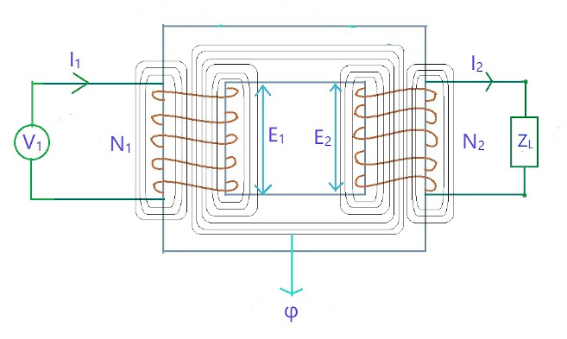
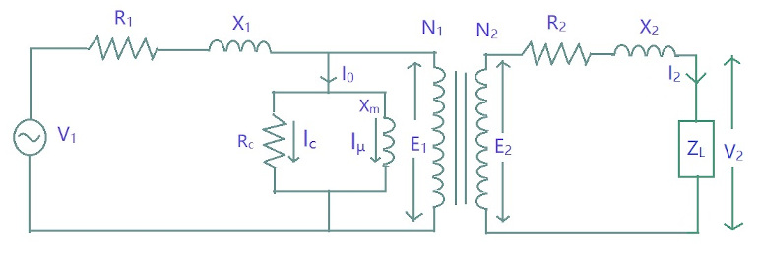
Practical Transformer on Load
The secondary side is closed-circuited with a load.
Its equivalent circuit diagram:

Slide 42
where on primary side,
V₁ is Primary Voltage
I₁ is Primary Current
I'₂ is Primary Current to neutralize the demagnitizing
effects of I₂, I'₂ = K I₂
I₀ is No Load Primary Current
R₁ is Primary Winding Resistance
X₁ is Primary Leakage Reactance
I_{c} is Core Loss component of I₁
I_{μ} is Magnetizing Component of I₁
I'₁ component of I₁ (doubtful)
R_{c} is Core loss resistance
X_{m} is Magnetizing Reactance
N₁ is Number of turns in Primary Winding
E₁ is Primary induced Emf

Slide 43
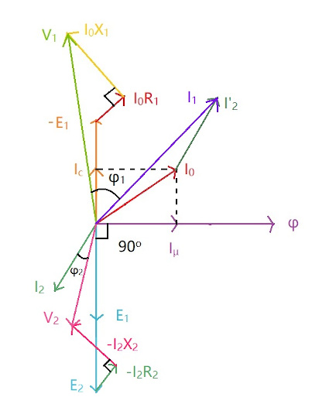
On secondary side,R₂ is Secondary winding resistance
X₂ is Secondary leakage reactance
N₂ is Secondary winding turns
E₂ is Secondary induced emf
V₂ is Secondary voltage
I₂ is Secondary current
Phasor Diagram

Slide 44

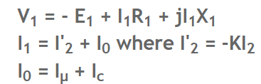
Explanation
Again we will start with refrence line, here it is φ. Using KVL in secondary circuit,
As there is no direct relation between V₁ and φ so we will use the equation to draw all three quantities and then add them to get V₁.
E₂ and E₁ lag φ by 90 degrees. Here we will consider E₂ < E₁. I₂ lags E₂ by phase difference of φ₂
Now voltage drop I₂R₂ across R₂ will be in phase with I₂ but we need -I₂R₂ so we will it in opposite direction of I₂. As it is to be added to E₂ so it will be drawn at the head of E₂. I₂X₂ is voltage drop across X₂ and is leading by 90 degrees from I₂R₂. Again it is -ve in magnitude. Adding all the quantities we have V₂.
Now in primary circuit,

Slide 45
Again we will draw I_{μ} first as it is directly connected to φ, then I_{c} and then I₀ .
I'₂ is opposite to I₂ and is added to I₀. The resultant phasor is I₁. I₁R₁ is in phase with I₁ and is added to -E₁. I₁X₁ is 90 degrees leading I₁R₁.
Phase difference between V₁ and I₁ is φ₁
Power Factor = cosφ₁ Input Power = V₁I₁cosφ₁
Phase difference between V₂ and I₂ is φ₂
Power Factor = cosφ₂ Input Power = V₂I₂cosφ₂

Slide 46
Equivalent Circuit of Electrical Transformer
An equivalent circuit of a transformer is a graphical representation of a transformer circuit in which the resistance and leakage reactance are imagined to be external to the winding.
The exact equivalent circuit of a transformer can be referred to as the primary or secondary side.
First, we derive the equivalent resistance and leakage reactance.

Slide 47
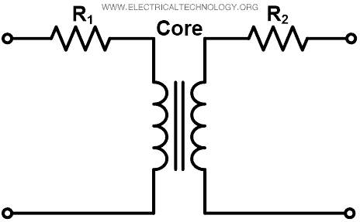
Equivalent Resistance
In a practical transformer, we need to consider winding resistance. The resistance of two windings can be transferred to any one of two windings.
It can be transferred to either the primary or secondary side to make calculation easy and simple.
The winding resistance of the transformer is imagined by adding resistance in series as shown in the figure below.

Slide 48
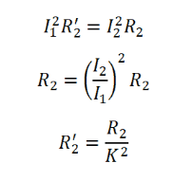
Where,
R₁ = Primary winding resistance
R₂ = Secondary winding resistance
Now, we transfer the primary winding resistance to the secondary side by introducing an additional resistance R₂’ in the primary winding.
This new resistance is added in such a way that the power absorbed by the resistance R₂’ when carrying primary current I₁ is equal to the power absorbed by the secondary resistance R₂ when carrying secondary current I₂.
Therefore,

Slide 49
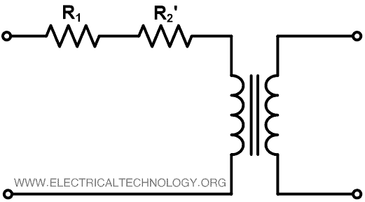
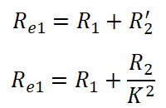
Where, K = Transformation ratio = I₁ / I₂
R₂’ is equivalent secondary resistance referred to the primary side and it is shown in the figure below.
As shown in the above figure, the effective resistance of transformer referred to primary sides is R_{e1};

Slide 50
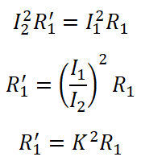
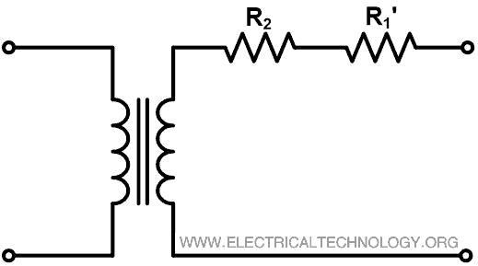
Similarly, we can transfer the primary resistance referred to the secondary side.
The equivalent circuit referred to as secondary is as shown in the figure below.

Slide 51
The total resistance of the transformer referred to secondary side is R_{e2}.
R_{e2} = R₂ + R₁‘
R_{e2} =R₂ + K² R₁

Slide 52
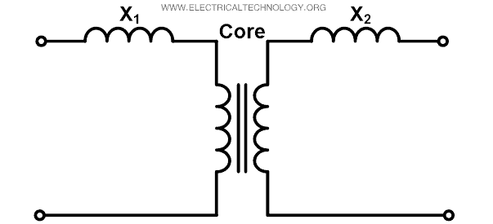

Equivalent Leakage Reactance
The leakage reactance of both windings can be transferred to any one of winding similar to the resistance. The imaginary reactance of both windings is added as shown in the figure below.
The equivalent secondary leakage reactance referred to the primary winding is X₂‘;

Slide 53
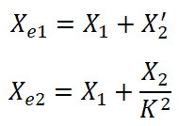
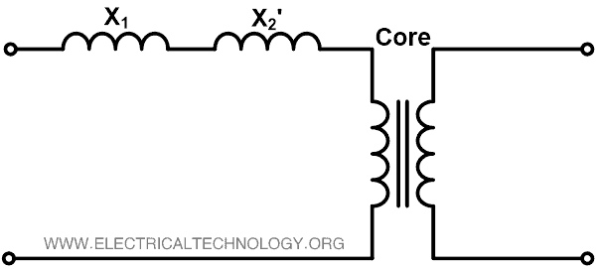
The total equivalent reactance of transformer referred to the primary side is X_{e1};
Similarly, equivalent primary leakage reactance referred to secondary is X₁’;
X_{1‘} = K² X₁

Slide 54
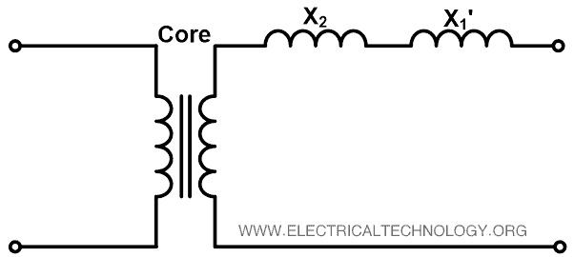
The total equivalent reactance of transformer referred to secondary side is X_{e2}.
X_{e2} = X₂ +X_{1‘}
X_{e2} = X₂ +K² X₁
Now, Let’s find the equivalent impedance of the transformer by adding equivalent resistance and reactance.

Slide 55
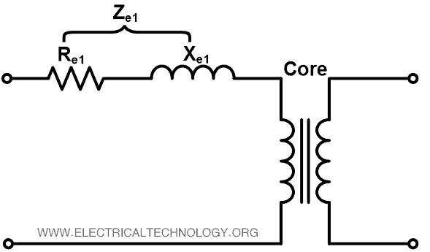
Equivalent impedance referred to the primary side is Z_{e1};
Z_{e1} = R_{e1} + X_{e1}

Slide 56
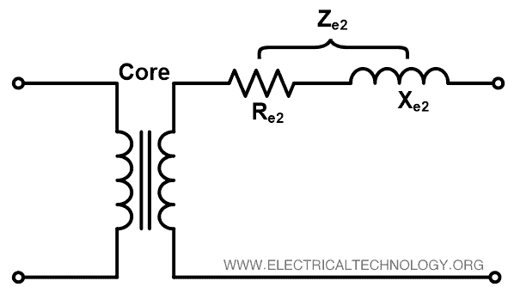
Equivalent impedance referred to secondary side is Z_{e2}.
Z_{e2} = R_{e2} + X_{e2}

Slide 57
Equivalent Circuit of Transformer
In the exact equivalent circuit of a transformer based on ideal transformer, we need to consider the no-load current.
No-load current is a vector summation of working component I_{W} and magnetizing component I_{μ}. The working component of the no-load current passes through the pure resistance R₀ and magnetizing component passes through the pure inductance X₀.
We can find the exact equivalent circuit of a transformer by adding a no-load component with resistances and reactances as shown in the figure below.

Slide 58
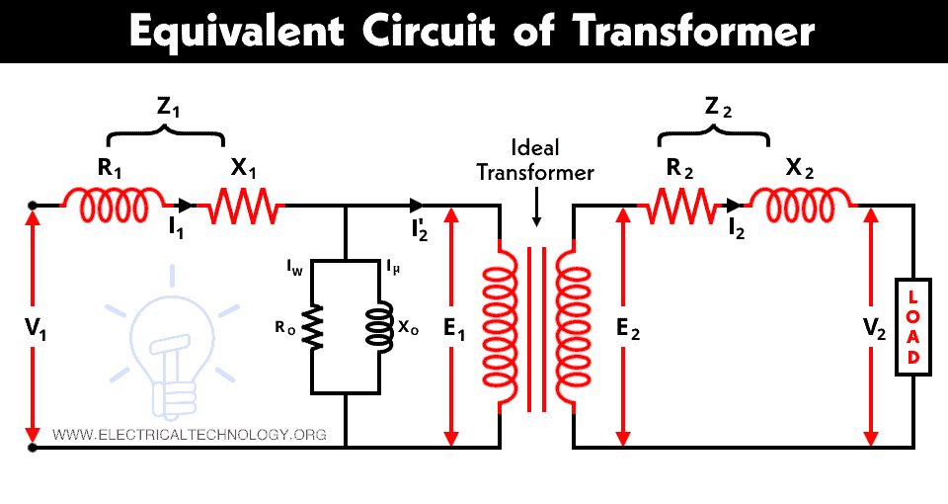

Slide 59
Where,
V₁ = Supply voltage to the primary winding
V₂ = Load voltage
V₁ = E₁ + I₁ Z₁
E₂ = V₂ + I₂ Z₂
No-load resistance R₀ represents the iron and core losses and the working component IW supplies the core losses. No-load inductance X₀ represents a loss-free coil and the magnetizing component I_{μ} passes through X₀.
Now, to simplify the above equivalent circuit, transfer the resistance, reactance, voltage, and current either to the primary or secondary side.

Slide 60



Equivalent Circuit Referred to Primary Side
In an equivalent circuit referred to the primary side, we will transfer all elements of the secondary side to the primary side.
Secondary induced EMF E₂ referred to primary side;
Secondary terminal voltage (load voltage) V₂ referred to the primary side;
Secondary resistance R₂ referred to the primary side;

Slide 61

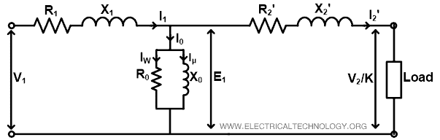
Secondary reactance X₂ referred to the primary side;
The simplified exact equivalent circuit of transformer referred to the primary side is shown in the figure below.
In the above circuit, the no-load component (resistance R₀ and reactance X₀) can be transferred before the primary resistance and reactance. By doing this, a very small error will introduce. But it can be neglected. So, the equivalent circuit looks like the figure below. This circuit is also known as an approximate equivalent circuit of transformer referred to the primary side.

Slide 62
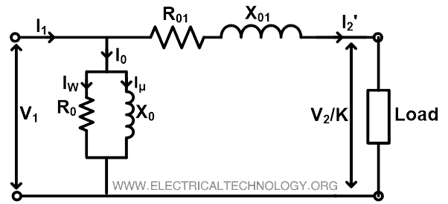
Now, for simplification, we can add primary and secondary resistance and reactance.
R₀₁ = R₁ + R‘₂
X₀₁ = X₁ + X‘₂

Slide 63
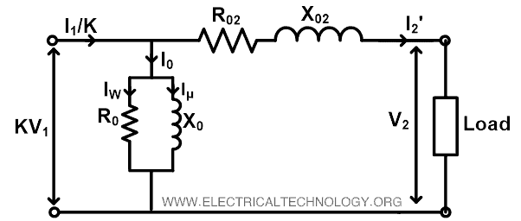
Similarly, we can find the approximate equivalent circuit referred to the secondary side and this circuit is shown in the figure below.
Where,
Primary resistance referred to the secondary side;
R‘₁ = K² R₁
Primary reactance referred to the secondary side;
X‘₁ = K² X₁
Hence, the total resistance is;
R₀₂ =R‘₁ + R₂
And total reactance is;
X₀₂ =X‘₁ + X₂

Slide 64
Equivalent Circuit Of Transformer
In a practical transformer -
(a) Some leakage flux is present at both primary and secondary sides. This leakage gives rise to leakage reactances at both sides, which are denoted as X₁ and X₂ respectively. (b) Both the primary and secondary winding possesses resistance, denoted as R₁ and R₂ respectively. These resistances causes voltage drop as, I₁R₁ and I₂R₂ and also copper loss I₁²R₁ and I₂²R₂. (c) Permeability of the core can not be infinite, hence some magnetizing current is needed. Mutual flux also causes core loss in iron parts of the transformer.
We need to consider all the above things to derive equivalent circuit of a transformer.

Slide 65
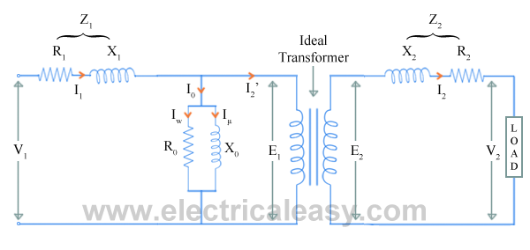
Equivalent Circuit Of Transformer
Resistances and reactances of transformer, which are described above, can be imagined separately from the windings (as shown in the figure below). Hence, the function of windings, thereafter, will only be the transforming the voltage.
The no load current I₀ is divided into, pure inductance X₀ (taking magnetizing components I_{μ}) and non induction resistance R₀ (taking working component I_{w}) which are connected into parallel across the primary.
The value of E₁ can be obtained by subtracting I₁Z₁ from V₁. The value of R₀ and X₀ can be calculated as, R₀ = E₁ / I_{w} and X₀ = E₁ / I_{μ}.

Slide 66
But, using this equivalent circuit does not simplifies the calculations. To make calculations simpler, it is preferable to transfer current, voltage and impedance either to primary side or to the secondary side.
In that case, we would have to work with only one winding which is more convenient. From the voltage transformation ratio, it is clear that,
E₁ / E₂ = N₁ / N₂ = K Now, lets refer the parameters of secondary side to primary.
Z₂ can be referred to primary as Z₂’
where, Z₂' = (N₁/N₂)²Z₂ = K²Z₂. ............where K= N₁/N₂.
that is, R₂'+jX₂' = K²(R₂+jX₂)
equating real and imaginary parts,
R₂' = K²R₂ and X₂' = K²X₂ .
And V₂' = KV₂

Slide 67
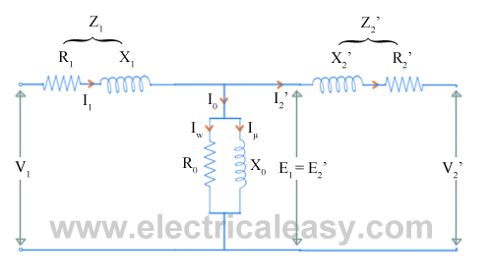
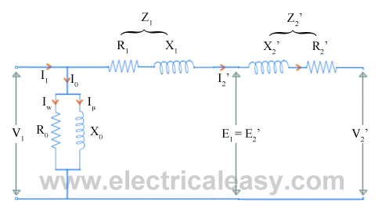
The following figure shows the equivalent circuit of transformer with secondary parameters referred to the primary.
Now, as the values of winding resistance and leakage reactance are so small that, V₁ and E₁ can be assumed to be equal. Therefore, the exciting current drawn by the parallel combination of R₀ and X₀ would not affect significantly, if we move it to the input terminals as shown in the figure below.

Slide 68
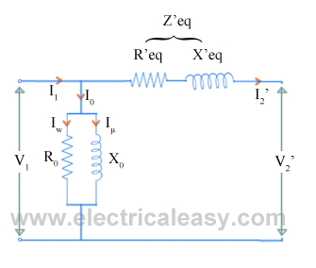
Now, let R₁ + R₂' = R'eq and X₁ + X₂' = X’eq
Then the equivalent circuit of transformer becomes as shown in the figure below

Slide 69
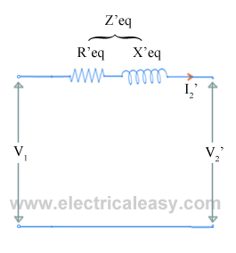
Approximate Equivalent Circuit Of Transformer
If only voltage regulation is to be calculated, then even the whole excitation branch (parallel combination of R0 and X0) can be neglected. Then the equivalent circuit becomes as shown in the figure below

Slide 70
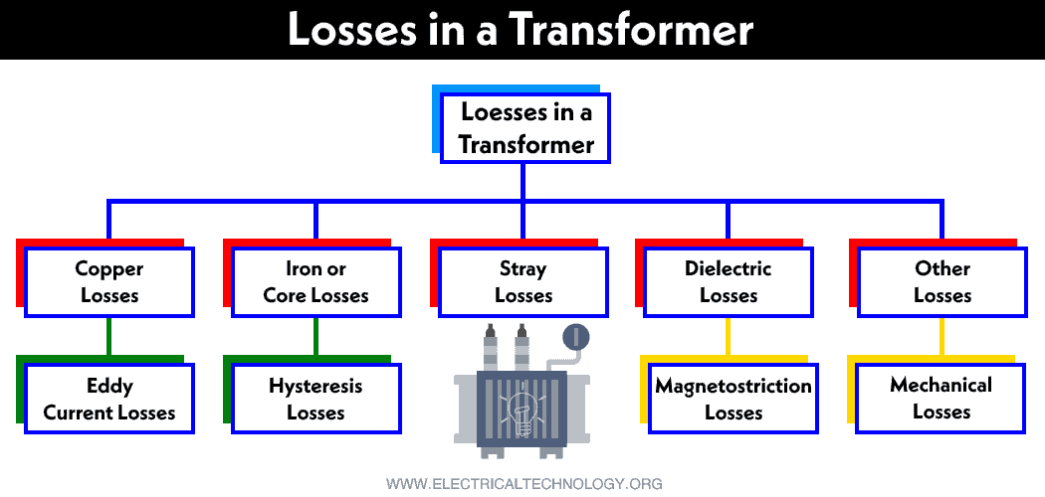
Transformer Losses – Different Types of Losses in a Transformer

Slide 71
An ideal transformer is very efficient, they don’t have energy losses. It means power supplied to the transformer’s input terminal must be equivalent to the power supplied to the transformer’s output one.
So the input power and output power in an ideal transformer are equal including zero energy losses.
In reality, both the input and output powers of the transformer will not equal because of electrical losses within the transformer.
Because the transformer is a static device, it doesn’t have any movable parts, so we cannot observe mechanical losses but electrical losses will occur like copper and iron.
There are different kinds of losses that will be occurred in the transformer such as copper, hysteresis, eddy, iron, stray & dielectric.
The copper loss commonly occurs due to the resistance in the transformer winding whereas hysteresis losses will be occurred due to the magnetization change within the core.

Slide 72
1. Core Losses Or Iron Losses
Eddy current loss and hysteresis loss depend on the magnetic properties of the material used for the construction of the core. So, these losses are also known as core losses or iron losses.
Hysteresis loss in transformer: The reason is the reversal of magnetization in the transformer core. This loss depends on the volume and grade of the iron, frequency of magnetic reversals and value of flux density. We have the Steinmetz formula:
Wh= ηBmax1.6fV (watts)
Where, η = Steinmetz hysteresis constant
V = volume of the core in m3

Slide 73
Eddy current loss in transformer: The AC current is supplied to the primary winding which sets up alternating magnetizing flux in the transformer. When this flux flow to a secondary winding, it produces induced emf in it.
But some part of this flux also gets linked with other conducting parts such as steel core or iron body or the transformer, which will result in induced emf in those parts, causing small circulating current in them.
This current is called as eddy current. Due to the current, some energy will be dissipated in the form of heat.
W_{e} = P B_{max}² f² t² … Watts
W_{e} = K_{e} B_{max}² f² t² v … Watts
Where:
W_{e} = Eddy current losses in Watts
K_{e} = Coefficient of eddy current
B_{max} = Maximum value of flux density in wb/m²
f = Supply frequency in Herts
T = Thickness of lamination in meters
v = Volume of the magnetic material in m³

Slide 74
Copper Losses (Winding Resistance)
The electric current flowing through the windings causes resistive heating of the conductors.
At higher frequencies, skin effect and proximity effect create additional winding resistance and losses. The total copper losses in a transformer can be found using the following equation.
I₁²R₁ + I₂²R₂ = I₁²R ₀₁ + I₂²R ₀₂
W_{C} = I₁²R₁ + I₂²R₂
_{(Or)}
The ohmic resistance of the transformer windings creates copper loss. The copper loss for the primary winding is I12R1 and for the secondary winding is I22R2.
Where, I1 and I2 are current in primary and secondary winding respectively, R1 and R2 are the resistances of primary and secondary winding respectively.
We can see that Cu loss is proportional to square of the current, and current depends on the load. So that copper loss in transformer varies with the load

Slide 75
3. Stray Loss
The reason for the types of loss is the occurrence of the leakage field. When compared with copper and iron losses, the percentage of stray losses are less, so these losses can be neglected.
4. Dielectric Loss
The oil of the transformer is the reason for this loss. Oil in transformer is an insulating material. When the oil in the transformer gets deteriorates then the transformer’s efficiency will be affected.

Slide 76
Open Circuit and Short Circuit Test on Transformer
The open circuit and short circuit test are performed for determining the parameter of the transformer like their efficiency, voltage regulation, circuit constant etc.
These tests are performed without the actual loading and because of this reason the very less power is required for the test. The open circuit and the short circuit test gives a very accurate result as compared to the full load test.
Open Circuit Test
The purpose of the open-circuit test is to determine the no-load current and losses of the transformer because of which their no-load parameters are determined. This test is performed on the primary winding of the transformer.
The wattmeter, ammeter and the voltage are connected to their primary winding. The nominal rated voltage is supplied to their primary winding with the help of the ac source.

Slide 77
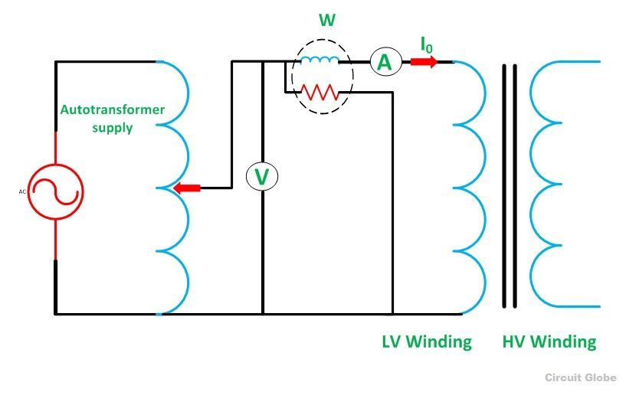
Circuit Diagram of Open Circuit Test on Transformer

Slide 78

The secondary winding of the transformer is kept open, and the voltmeter is connected to their terminal. This voltmeter measures the secondary induced voltage. As the secondary of the transformer is open, thus no-load current flows through the primary winding.
The value of no-load current is very small as compared to the full rated current. The copper loss occurs only on the primary winding of the transformer because the secondary winding is open.
The reading of the wattmeter only represents the core and iron losses. The core loss of the transformer is the same for all types of loads.
Calculation of open-circuit test
Let,
W₀ – wattmeter reading
V₁ – voltmeter reading
I₀ – ammeter reading
Then the iron loss of the transformer P_{i} = W₀ and

Slide 79




The no-load power factor is
Working component I_{w} is
Putting the value of W₀ from the equation (1) in equation (2) you will get the value of the working component as
Magnetizing component is

Slide 80

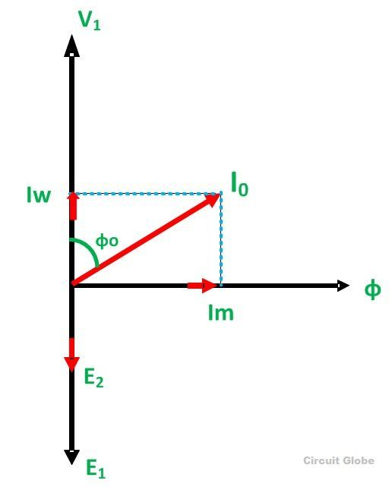

No-load parameters are given below:
Equivalent exciting resistance is
Equivalent exciting reactance is
The phasor diagram of the transformer at no load or when an
open circuit test is performed is shown below
The iron losses measured by the open circuit test is used for
calculating the efficiency of the transformer.

Slide 81
Short Circuit Test
The short circuit test is performed for determining the below mention parameter of the transformer.
It determines the copper loss occur on the full load. The copper loss is used for finding the efficiency of the transformer.
The equivalent resistance, impedance, and leakage reactance are known by the short circuit test.
The short circuit test is performed on the secondary or high voltage winding of the transformer. The measuring instrument like wattmeter, voltmeter and ammeter are connected to the high voltage winding of the transformer.
Their primary winding is short-circuited by the help of thick strip or ammeter which is connected to its terminal.
The low voltage source is connected across the secondary winding because of which the full load current flows from both the secondary and the primary winding of the transformer.
The full load current is measured by the ammeter connected across their secondary winding.

Slide 82
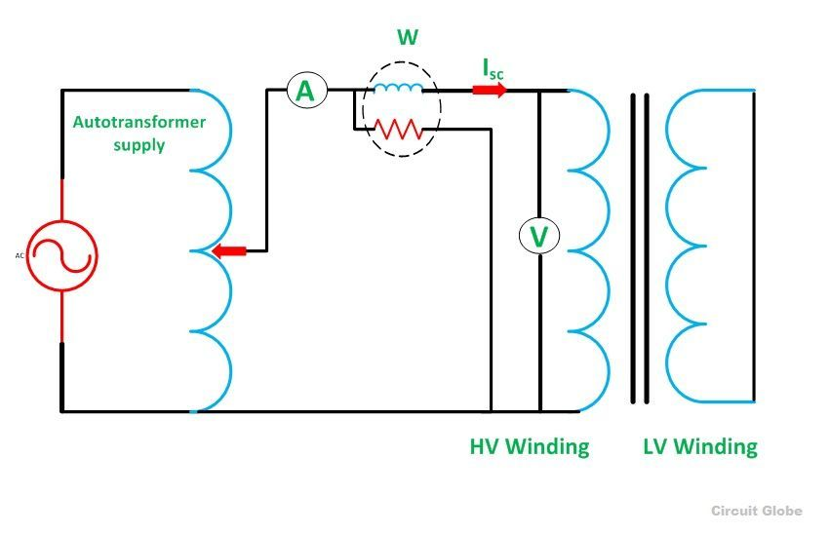
The circuit diagram of the short circuit test is shown below:

Slide 83

The low voltage source is applied across the secondary winding, which is approximately 5 to 10% of the normal rated voltage.
The flux is set up in the core of the transformer. The magnitude of the flux is small as compared to the normal flux.
The iron loss of the transformer depends on the flux. It is less occur in the short circuit test because of the low value of flux. The reading of the wattmeter only determines the copper loss occurred, in their windings.
The voltmeter measures the voltage applied to their high voltage winding. The secondary current induces in the transformer because of the applied voltage.
Calculation of Short Circuit Test
Let,
W_{c} – Wattmeter reading
V_{2sc} – voltmeter reading
I_{2sc} – ammeter reading
Then the full load copper loss of the transformer is given by

Slide 84

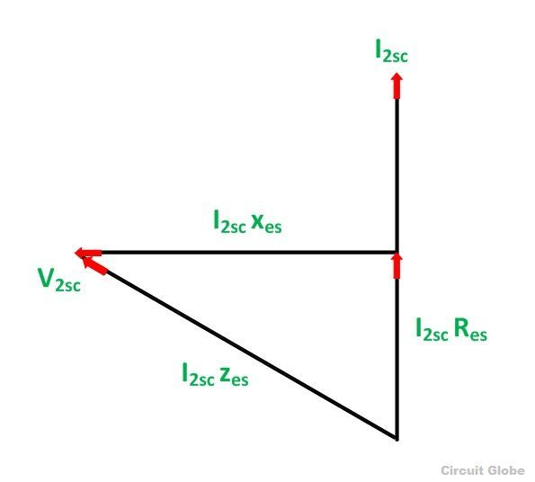



Equivalent resistance referred to the secondary side is
The phasor diagram of the short circuit test of the transformer is shown below
From the phasor diagram
Equivalent impedance referred to the secondary side is given by
The equivalent reactance referred to the secondary side is given by

Slide 85
The voltage regulation of the transformer can be determined at any load and power factor after knowing the values of Z_{es} and R_{es}.
In the short circuit test the wattmeter record, the total losses, including core loss but the value of core loss are very small as compared to copper loss so the core loss can be neglected.

Slide 86

What is Transformer Efficiency?
Transformer efficiency (η) can be explained as the ratio of the output power to the input power.

Slide 87
As we know that in a transformer there is no rotational part so there are no rotational losses such as windings and frictional losses in a rotating machine. Therefore, we can obtain a maximum efficiency as high as 99% in a well-designed transformer.

Slide 88

What is all day (or energy) efficiency of a transformer?
The ratio of the energy output of 24-hour to the energy input of a 24-hour period is called the All-day efficiency of a transformer.
If we know the load cycle of the transformer, then all day efficiency can easily be determined.

Slide 89
What is Voltage Regulation?
Voltage regulation is a measure of change in the voltage magnitude between the sending and receiving end of a component. It is commonly used in power engineering to describe the percentage voltage difference between no load and full load voltages distribution lines, transmission lines, and transformers.
Explanation of Voltage Regulation of Transformer
Say an electrical power transformer is open circuited, meaning that the load is not connected to the secondary terminals. In this situation, the secondary terminal voltage of the transformer will be its secondary induced emf E₂.
Whenever a full load is connected to the secondary terminals of the transformer, rated current I₂ flows through the secondary circuit and voltage drop comes into picture.
At this situation, primary winding will also draw equivalent full load current from source. The voltage drop in the secondary is I₂Z₂ where Z₂ is the secondary impedance of transformer.

Slide 90

Now if at this loading condition, any one measures the voltage between secondary terminals, he or she will get voltage V₂ across load terminals which is obviously less than no load secondary voltage E₂ and this is because of I₂Z₂ voltage drop in the transformer.
Expression of Voltage Regulation of Transformer
The equation for the voltage regulation of transformer, represented in percentage, is
Voltage Regulation of Transformer for Lagging Power Factor
Now we will derive the expression of voltage regulation in detail.
Say lagging power factor of the load is cosθ₂, that means angle between secondary current and voltage is θ₂.

Slide 91



Here, from the above diagram,
Angle between OC and OD may be very small, so it can be neglected and OD is considered nearly equal to OC i.e.

Slide 92


Voltage regulation of transformer at lagging power factor,
Voltage Regulation of Transformer for Leading Power Factor
Let’s derive the expression of voltage regulation with leading current, say leading power factor of the load is cosθ₂, that means angle between secondary current and voltage is θ₂.

Slide 93



Here, from the above diagram,
Angle between OC and OD may be very small, so it can be neglected and OD is considered nearly equal to OC i.e.
Voltage regulation of transformer at leading power factor,

Slide 94
Zero Voltage Regulation of A Transformer
‘Zero voltage regulation’ indicates that there is no difference between its ‘no-load voltage’ and its ‘full-load voltage’. This means that in the voltage regulation equation above, voltage regulation is equal to zero. This is not practical – and is only theorectically possible in the case for an ideal transformer.

Slide 95
Three Phase Transformer
Three phase transformers are more economical for supplying large loads and large power distribution.
Even though most of the utilization equipments are connected by the single phase transformers, these are not preferred for large power distribution in the aspect of economy.
The three phase power is used in almost all fields of electrical power system such as power generation, transmission and distribution sectors, also all the industrial sectors are supplied or connected with three phase system.
Therefore, to step-up (or increase) or step-down (or decrease) the voltages in the three phase systems, three phase transformers are used.
As compared with the single phase transformer, there are numerous advantages with 3 phase transformer such as smaller and lighter to construct for the same power handling capacity, better operating characteristics, etc.

Slide 96
Three Phase Transformer
Three phase transformers are used to step-up or step-down the high voltages in various stages of power transmission system.
The power generated at various generating stations is in three phase nature and the voltages are in the range of 13.2KV or 22KV. In order to reduce the power loss to the distribution end, the power is transmitted at somewhat higher voltages like 132 or 400KV.
Hence, for transmission of the power at higher voltages, three phase step-up transformer is used to increase the voltage. Also at the end of the transmission or distribution, these high voltages are step-down to levels of 6600, 400, 230 volts, etc.
For this, a three phase step down transformer is used.

Slide 97
A three phase transformer can be built in two ways; a bank of three single phase transformers or single unit of three phase transformer.
The former one is built by suitably connecting three single phase transformers having same ratings and operating characteristics.
In this case if the fault occurs in any one of the transformers, the system still retained at reduced capacity by other two transformers with open delta connection.
Hence, continuity of the supply is maintained by this type of connection.
These are used in mines because easier to transport individual single phase transformers.

Slide 98


Slide 99
Instead of using three single phase transformers, a three phase bank can be constructed with a single three phase transformer consisting of six windings on a common multi-legged core.
Due to this single unit, weight as well as the cost is reduced as compared to three units of the same rating and also windings, the amount of iron in the core and insulation materials are saved.
Space required to install a single unit is less compared with three unit bank.
But the only disadvantage with single unit three phase transformer is if the fault occurs in any one of the phase, then entire unit must be removed from the service.

Slide 100

Working of Three Phase Transformers
Consider the below figure in which the primary of the transformer is connected in star fashion on the cores.
For simplicity, only primary winding is shown in the figure which is connected across the three phase AC supply.
The three cores are arranged at an angle of 120 degrees to each other. The empty leg of each core is combined in such that they form center leg as shown in figure.

Slide 101
When the primary is excited with the three phase supply source, the currents IR, IY and IB are starts flowing through individual phase windings.
These currents produce the magnetic fluxes ΦR, ΦY and ΦB in the respective cores. Since the center leg is common for all the cores, the sum of all three fluxes are carried by it. In three phase system, at any instant the vector sum of all the currents is zero.
In turn, at the instant the sum of all the fluxes is same. Hence, the center leg doesn’t carry any flux at any instant. So even if the center leg is removed it makes no difference in other conditions of the transformer.
Likewise, in three phase system where any two conductors acts as return for the current in third conductor, any two legs acts as a return path of the flux for the third leg if the center leg is removed in case of three phase transformer.
Therefore, while designing the three phase transformer, this principle is used.
These fluxes induce the secondary EMFs in respective phase such that they maintain their phase angle between them.
These EMFs drives the currents in the secondary and hence to the load. Depends on the type of connection used and number of turns on each phase, the voltage induced will be varied for obtaining step-up or step-down of voltages.

Slide 102
Three Phase Transformer Connections
As discussed above, either by a single three phase transformer or by three single phase transformers combination, three phase transformations can be carried out.
The way of connecting the windings for three phase transformation is same whether the three windings of a three phase transformer or three windings of three single phase transformers are used.
The primary and secondary windings are connected in different ways, such as in delta or star or combination of these two. The voltage and current ratings of the three phase transformer is depends on suitable connection.
The most commonly used connections are
Star-delta
Delta-star
Delta-delta
Star-star

Slide 103

Star – Delta Connection

Slide 104
This type of connection is commonly used to step-down the voltages to a lower value in transmission end substations. Utility companies use this connection to reduce the voltage levels for distribution systems.
In this, the primary winding of the transformer is connected in star and secondary in delta connection.
The neutral point on the primary or high voltage side can be grounded which is desirable in most of the cases.
The line voltage ratio between secondary and primary is 1/√3 times the transformation ratio of each transformer.
There exists 30 degrees phase difference between primary and secondary line voltages.
Since the actual primary coil voltage is 58% of the primary line voltage, the insulation requirements for HV windings is reduced by using this winding.
In this connection balanced three phase voltage are obtained at the secondary or LV side, even when the unbalanced currents are flowing the in the primary or HV side due to neutral wire. The neutral wire grounding also provides lightning surge protection.

Slide 105

Delta – Star Connection

Slide 106
This connection is used to step-up the voltage level and is commonly employed in sending end or starting of high tension transmission system.
In this, the primary is connected in delta fashion and secondary in star fashion so that three phase 4 wire system at secondary is possible.
The secondary voltage to the load is √3 times the delta connected primary voltage. Also the load and secondary currents will be the same due to the same series circuit.
This connection provides three single phase circuits at both lower and higher voltages and one three phase circuit at higher voltage so that single and three phase loads can be supplied.
Dual voltages are obtained delta-star connection. Low single phase voltages are obtained by wiring between any phase and ground. Higher single phase voltages are obtained by wiring between any two phases. And by connecting all three phases to the load, three phase voltage is obtained.
The insulation requirement on high voltage side is lowered due to the star (less number of turns per phase) connected secondary.
Similar to star-delta, this connection causes to create a 30 degrees phase difference between primary and secondary line voltages.
By using this connection, it is not possible to connect it parallel with delta-delta and star-star transformers due to the primary and secondary voltage phase difference.

Slide 107

Delta-delta

Slide 108
This type of connection is used when the supply source is delta connected and the secondary load needs single voltage with high current. This is generally employed for three phase power loads (like three phase motor).
In this, both primary and secondary windings are connected in delta fashion.
The voltage across the load is equal to the secondary voltage and voltage across the primary winding is equal to source voltage.
In this, the current flow through the load will be 1.732 times the secondary current and the feeder current will equal to the 1.732 times current through the primary winding.
Due to these high supply and load currents, it is recommended to place transformer much closer to both source and load circuits.
In this, there exists no phase difference between the primary and secondary voltages.
The three phase voltages remains constant even with unbalanced load, thus allows unbalanced loading.
The main advantage of this connection is if the one transformer is defective or removed for service (open delta connection), then remaining two transformers continue to deliver thee phase power at reduced load capacity.

Slide 109
Three-Phase Transformer Construction
A three phase transformer is used to transfer a large amount of power. The three phase transformer is required to step-up and step-down the voltages at various stages of a power system network. The three phase transformer is constructed in two ways.
Three separate single phase transformer is suitably connected for three phase operation.
A single three-phase transformer in which the cores and windings for all the three phases are merged into a single structure.
The three single-phase transformer can be used as a three-phase transformer when their primary and secondary winding are connected to each other. The three phase transformer supply has many advantages as compared to three single phase units like it requires very less space and also very lighter smaller and cheaper in size. The three phase transformer is mainly classified into two types, i.e., the core type transformer and the shell type transformer.
Core Type Three Phase Transformer
Consider a three single phase core type transformer positioned at 120° to each other as shown in the figure below

Slide 110

If the balanced three-phase sinusoidal voltages are applied to the windings, the fluxes φ_{a}, φ_{b} and φ_{c} will also be sinusoidal and balanced.
If the three legs carrying these fluxes are combined, the total flux in the merged leg becomes zero.
This leg can, therefore, be removed because it carries the no flux. This structure is not convenient for the core.
The core of the three phase transformer is usually made up of three limbs
in the same plane. This can be built using stack lamination.
The each leg of this core carries the low voltage and high voltage winding.
The low voltage windings are insulated from the core than the high voltage windings.

Slide 111

The low windings are placed next to the core with suitable insulation between the core and the low voltage windings.
The high voltage windings are placed over the low voltage windings with suitable insulation between them.
The magnetic paths of the leg a and c are greater than that of leg b, the construction is not symmetrical, and there is a resultant imbalance in the
magnetising current.
Shell type Three Phase Transformer
The shell type 3-phase transformer can be constructed by stacking three single phase shell transformer as shown in the figure below.
The winding direction of the central unit b is made opposite to that of units a and c.
If the system is balanced with phase sequence a-b-c, the flux will also be balanced

Slide 112

The magnitude of this combined flux is equal to the magnitude of each of its components.
The cross section area of the combined yoke is same as that of the outer leg and top and bottom section of the yoke.
The imbalance in the magnetic path has very little effect on the performance of the three shell-type transformers.
The windings of the shell type three phase transformer are either connected in delta or star as desired.

